Slide 1

Data Dynamo
Adam Chua
Jaden Fong
Larissa Domingo
Dylan Ton

Slide 2
Introduction
01
Background and Problem Statement

Slide 3

Background
Our Stakeholder: EmberSpark Games (start-up company)
Motto: Ignite the Future of Gaming
Our Goal: Provide Insights for a Successful Launch
Data Analysis & Strategy
Product Development
Innovation & Growth

Slide 4
Problem Statement
Which factors should EmberSpark Games prioritize to achieve market success?

Slide 5
OUR PROCESS
Results
06
01
Understand Business Objective
Data Visualizations
Data Collection
05
02
Data Analysis; Machine Learning
04
03
Data Cleaning

Slide 6
Predictive
Model
02
This predictive model allows us to visualize patterns between Genres, Scores, Ratings, and Sales to make predictions for future outcomes

Slide 7
Multiple Linear Regression Model
Multiple Linear Regression: Uses various factors to predict a specific result
Result: We are predicting ‘Global Sales Revenue’
A higher coefficient = greater positive impact on sales revenue
A lower coefficient = greater negative impact on sales revenue
Coefficient: A measure of impact that a specific factor has on Global Sales
User & Critic Scores
Genres
Rating

Slide 8
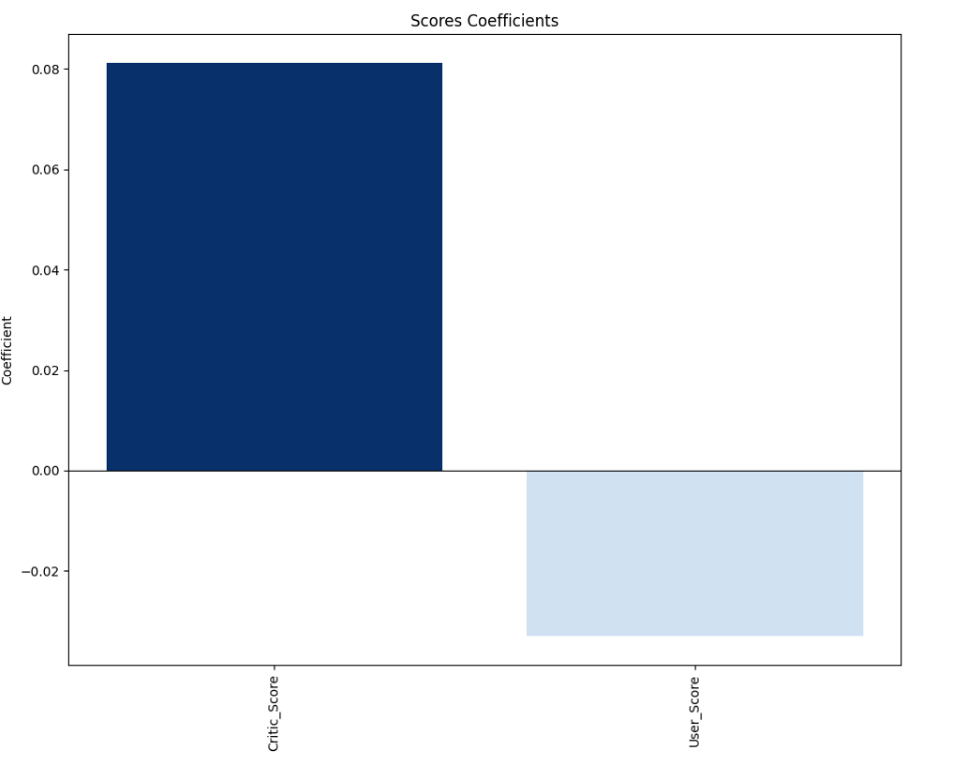
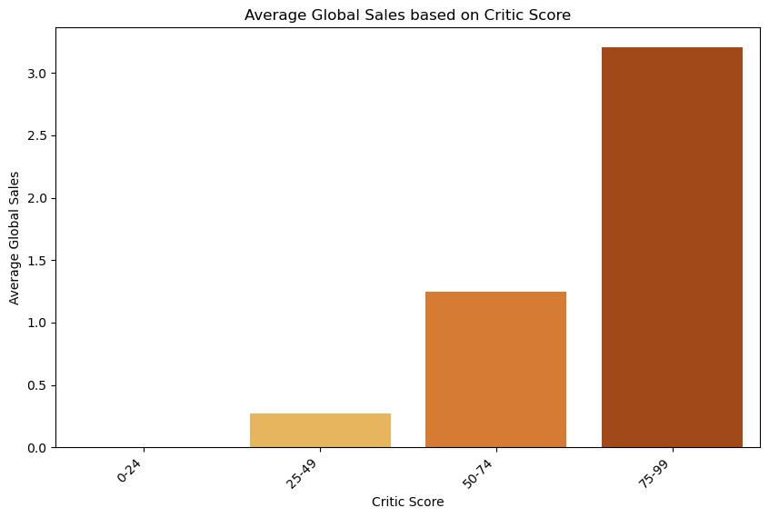
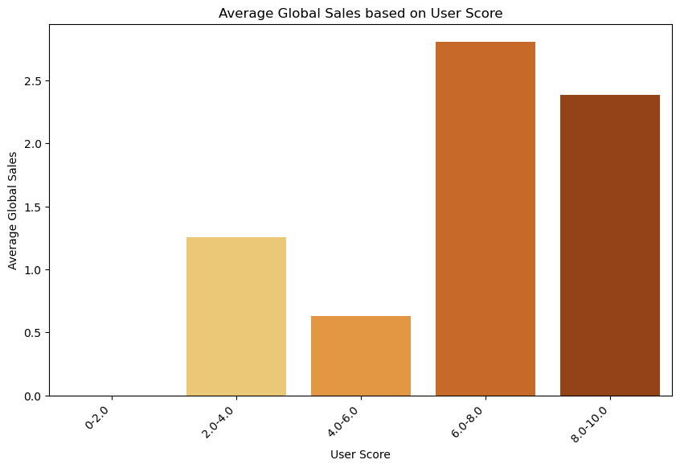
Scores
Critic Scores w/ Higher Average Global Sales = Critic Scores w/ Positive Coefficients
User Scores w/ Lower Average Global Sales = User Scores w/ Negative Coefficients

Slide 9
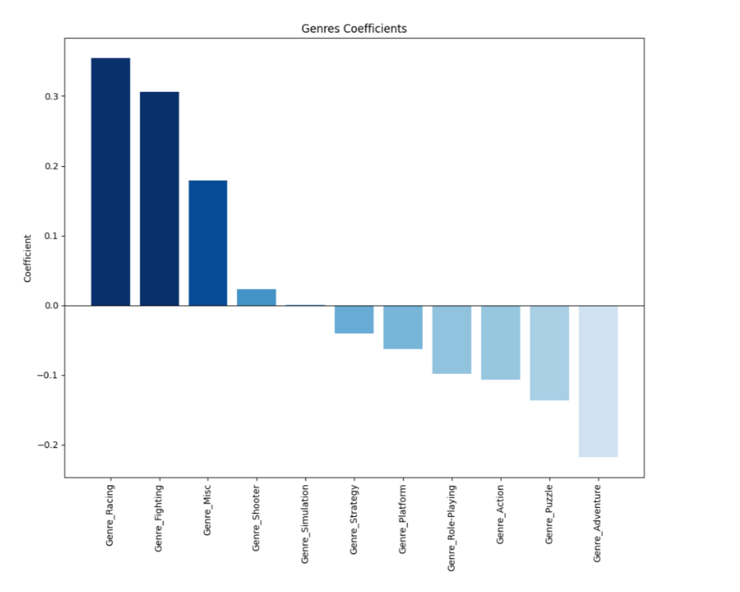
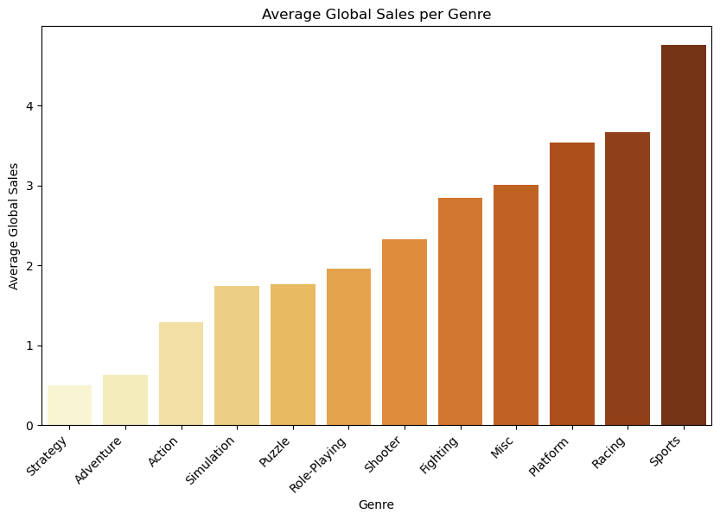
Genres
Genres w/ Higher Average Global Sales = Genres w/ Positive Coefficients
Genres w/ Lower Average Global Sales = Genres w/ Negative Coefficients

Slide 10
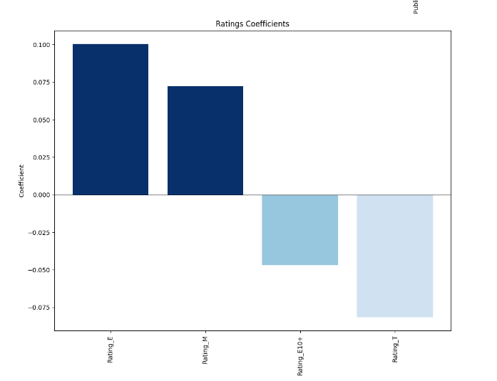
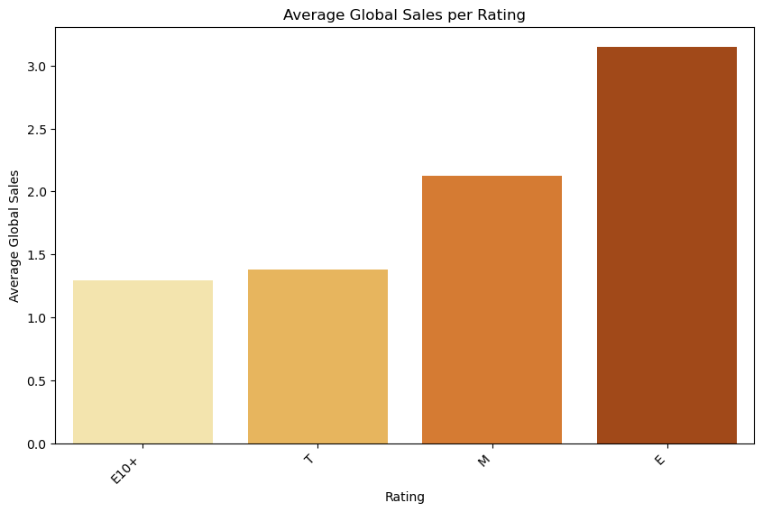
Rating Coefficients
Ratings w/ Higher Average Global Sales = Ratings w/ Positive Coefficients
Genres w/ Lower Average Global Sales = Genres w/ Negative Coefficients

Slide 11
INTERACTIVE DASHBOARD
03
This supplementary dashboard supports our findings and provides information on future analyses

Slide 12
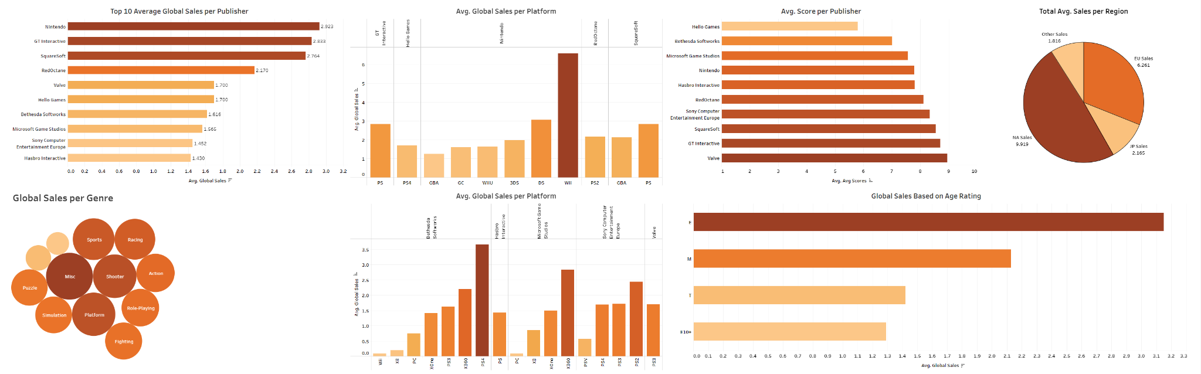
Dashboard Preview
Dashboard Link

Slide 13
Recommendations
04

Slide 14



What EmberSpark Should Do
 | Scores | Genres | Rating
Type | Critic Score | Racing, Fighting, Misc, Shooter | E (everyone), M (17+)
Focus | Making products to cater towards critics | Making these types of games | Marketing to older or younger audience
Action Plans | Early Access Critic Events Playtesting User Feedback | Train employees in these genres Focus on user feedback from these genres | Influencer Partnerships Social Media Campaigns

Slide 15
Thank You!
Look through our Dashboard for more further insights!

